Slide 1
MICROPROCESSOR-BASED AUTOMATIC ATTENDANCE RECORDER USING RFID
21CSS201T
COMPUTER ORGANIZATION & ARCHITECTURE
MINI PROJECT
BY ANITEJ MISHRA (RA2211029010023), KARTIKEY MISHRA (RA2211029010022), PREM LOHIA (RA2211029010007) AND CHIRANJEEV KUMAR (RA2211029010019)

Slide 2
TITLE
Microprocessor-based Automatic Attendance Recorder using Radio Frequency Identification (RFID)
Group Members
Prem Lohia (RA2211029010007)
Chiranjeev Kumar (RA2211029010019)
Kartikey Mishra (RA2211029010022)
Anitej Mishra (RA2211029010023)
Course: Computer Organization and Architecture-21CSS201T
Faculty: Dr S. Ramesh

Slide 3
PROBLEM STATEMENT
STATEMENT:
Design and develop a Microprocessor-based Automatic Attendance Recorder using RFID technology to streamline and enhance the attendance tracking process in educational institutions and workplaces, addressing the challenges of manual attendance recording, inaccuracies, and time inefficiencies.
IN SIMPLER WORDS…
In many schools and workplaces, taking attendance is a time-consuming and error-prone task. People often use paper-based methods or manual entry into computer systems, which can lead to mistakes and waste valuable time.
Our project aims to solve this problem by creating a system that automatically records attendance using RFID technology. RFID tags or cards are given to individuals, and when they come into the designated area, the system will automatically register their attendance. This will save time, reduce errors, and make the attendance process much more efficient.

Slide 4
OBJECTIVE
The objectives of the project are:
To build a device to track a student or an employee’s attendance, working hours, log-in and log-out time of staff, or something that is suitable in other similar situations.
To simplify the process of attendance logging, retrieval and management for both the user and the organization implementing it.
To minimize malpractice or errors in attendance and calculation of working hours to ensure a free, secure and efficient environment for the user, as well as the management.

Slide 5
ABSTRACT AND INTRODUCTION
Radio Frequency Identification (RFID) is a new technology in communication system which can be defined as a medium used to identify and track the special tag implanted into an object or a living thing by using radio frequency waves. It is a wireless medium of communication that uses electromagnetic and electrostatic coupling in radio frequency portion of the spectrum to communicate between reader and tag through a variety of modulation and encoding schemes.
Nowadays, most universities use the conventional method of taking attendance by calling names or signing on paper, which is very time consuming and inefficient.
From that, by integrating various components, namely an RFID reader, RFID card, micro-controller, and Secure Digital Card (SD Card), a portable RFID based attendance system can be set up to address this problem.
Uniquely identifying each person based on RFID tag is one of its special abilities that can make the recording attendance process faster and easier compared to the conventional methods.

Slide 6
LITERATURE SURVEY
The use of Radio-frequency identification (RFID) technology in automated electronic environment and for tracking objects has been widely researched upon by researchers and deployed by various organizations as part of their automation systems.
In April of 2013, Zhang Yuru, Chen Delong and Tan Liping published “The Research and Application of College Student Attendance System based on RFID Technology”. Combined with the actual situation of college students class attendance system, the design of student attendance system nodes based on RFID has been proposed.
In their paper, the hardware node of system and the develop processes of related application have been detailed presentation. The designed system can not only improve the work efficiency but can also save human and material resources.

Slide 7
LITERATURE SURVEY
In January 2013, Sumita Nainan, Romin Parekh and Tanvi Shah published “RFID Technology Based Attendance Management System”.
The proposed framework can give another precise and less bulky method for taking understudy participation in school and switch the world-view of understudy's address participation checking in classroom.
An easy-to-use and cheap RFID-based Authentication System model has been effectively created. The model of the framework can give a few advantages over the customary strategy for taking participation.
This framework will help in programmed capacity of participation and guardians will be informed in instance of non-attendance. By utilizing the AVR controller, the framework guarantees quick operation, cost viability and low power utilization.

Slide 8
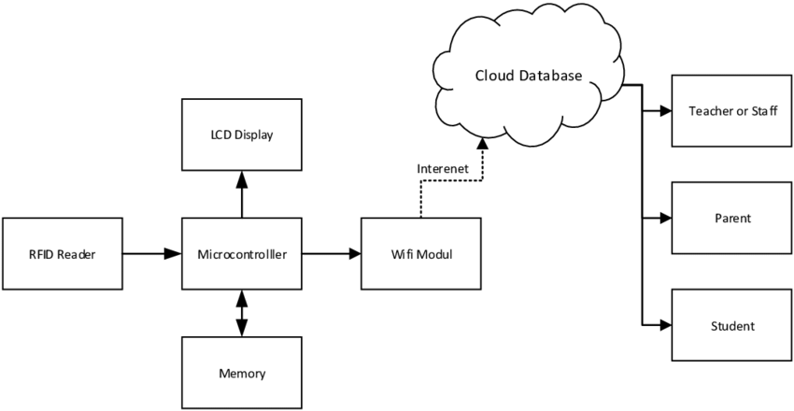
DIAGRAMS 1. BLACK BOX DIAGRAM
There are three main components in our project
The Cloud Database
The Attendance Reader/Controller
RFID Tags for the User

Slide 9
DIAGRAMS 1. BLACK BOX DIAGRAM
Database
It stores the credentials of the users, like Name, Unique ID and other details for verification purposes.
Multiple databases can be used, like Cloud Databases, CSV Files, etc.
RFID Tags
They are tags fused with RFID or NFC which have the details of the user embedded in them.
Once they are scanned with the microcontroller, it records the RFID tag holder as present and logs their attendance in the database.
Microcontroller and Sensor , i. e. Attendance Recorder
It is the main “hub” of the system per se.
It is linked to the database and also equipped with a sensor and an LCD display.
Once the user scans the RFID Tag with the controller, the Microcontroller verifies the user’s credentials and logs the attendance in the database.
The LCD display in the system shows an appropriate message to confirm whether the attendance has been logged or not.

Slide 10
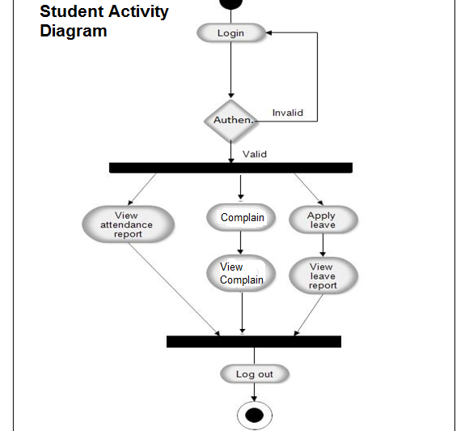
DIAGRAMS 2. ACTIVITY DIAGRAM

Slide 11
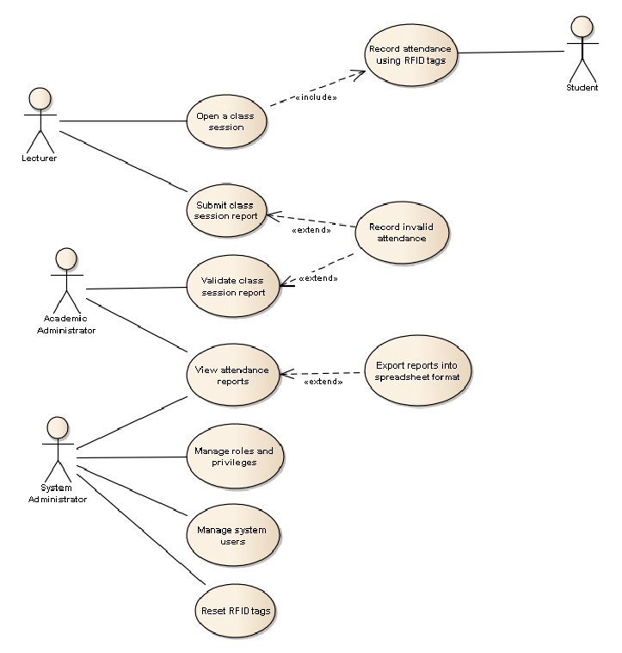
DIAGRAMS 3. USE CASE DIAGRAM

Slide 12
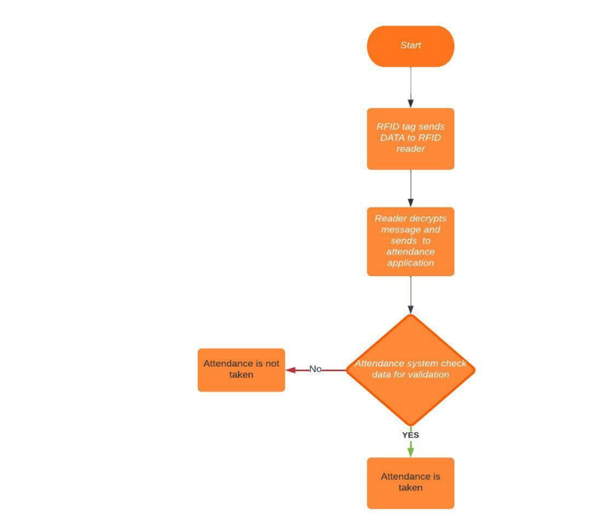
DIAGRAMS 4. FLOWCHART

Slide 13
REQUIREMENTS FOR THE PROJECT
HARDWARE
SOFTWARE
8051 Series Microcontroller
RFID Tags for each user
RFID Reader
LCD Display
Transformer
Rectifier
SD Card Module
Arduino Uno Board
Jumper Wires
Bread Board
Switch
Integrated Circuit (IC)
IC Sockets
Embedded C or Assembly Language
Arduino Integrated Development Environment (IDE) Software
Keil µVision IDE

Slide 14
CONCEPTS AND WORKING PRINCIPLE
Radio Frequency Identification (RFID) is a form of wireless communication that incorporates the use of electromagnetic or electrostatic coupling in the radio frequency portion of the electromagnetic spectrum to uniquely identify an object, an animal, or a person.
It uses radio frequency to search, identify, track, and communicate with items and people. it is a method that is used to track or identify an object by radio transmission uses over the web.
Data digitally encoded in an RFID tag which might be read by the reader. This device work as a tag or label during which data read from tags that are stored in the database through the reader as compared to traditional barcodes and QR codes. It is often read outside the road of sight either passive or active RFID.
There are two types of RFID: Active and Passive, based on whether they have their own independent power source (Active) or use the power from the reader (passive).

Slide 15
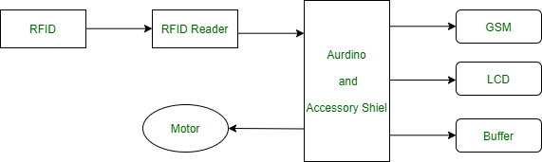
CONCEPTS AND WORKING PRINCIPLE
Generally, RFID uses radio waves to perform AIDC function. AIDC stands for Automatic Identification and Data Capture technology which performs object identification and collection and mapping of the data.
An antenna is a device which converts power into radio waves which are used for communication between reader and tag. RFID readers retrieve the information from RFID tag which detects the tag and reads or writes the data into the tag. It may include one processor, package, storage and transmitter and receiver unit.

Slide 16
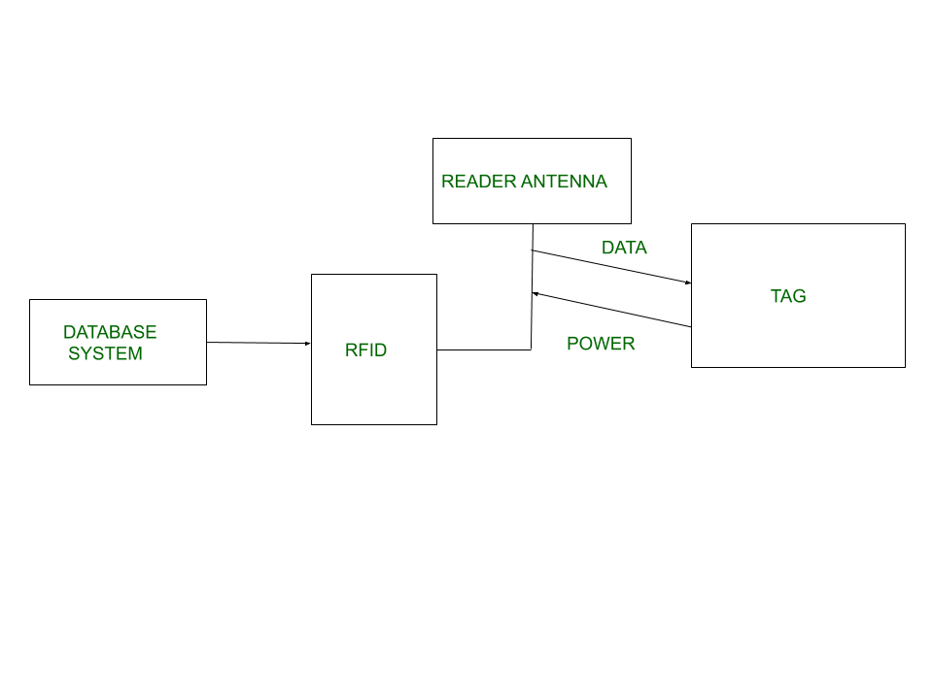
CONCEPTS AND WORKING PRINCIPLE
Every RFID system consists of three components: a scanning antenna, a trans-receiver, and a transponder. When the scanning antenna and transceiver are combined, they are referred to as an RFID reader or interrogator. There are two types of RFID readers — fixed readers and mobile readers. The RFID reader is a network-connected device that can be portable or permanently attached. It uses radio waves to transmit signals that activate the tag. Once activated, the tag sends a wave back to the antenna, where it is translated into data.
The transponder is in the RFID tag itself. The read range for RFID tags varies based on factors including the type of tag, type of reader, RFID frequency and interference in the surrounding environment or from other RFID tags and readers. Tags that have a stronger power source also have a longer read range.

Slide 17
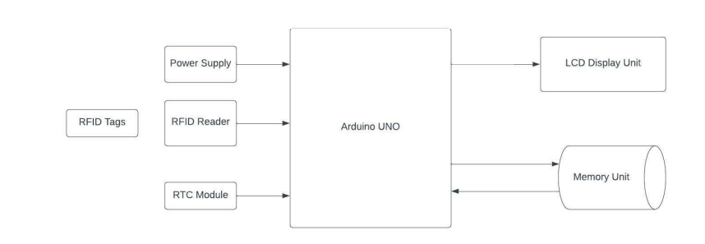
APPROACH AND METHODOLOGY
The block diagram shown on the right represents the control system in a diagrammatic form. In other words, it shows the practical representation of a control system. Each element of the control system is represented with a block and the block is the symbolic representation of the transfer function of that element. Here Arduino UNO acts as a central processor for controlling all other components as input/output unit.
The function of each block in the block diagram above is as follows:
RFID Reader: the input block consists of an RFID reader, the tag data card that the reader detects will be sent to the microcontroller.
Block microcontroller, data processor and central controller of the system.
Once it is verified by the microcontroller, data is stored in the memory unit.

Slide 18
APPROACH AND METHODOLOGY

Slide 19
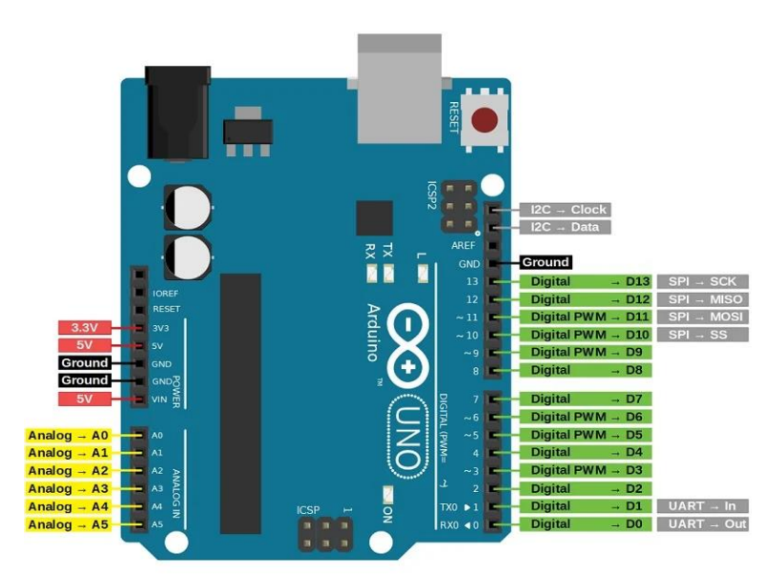
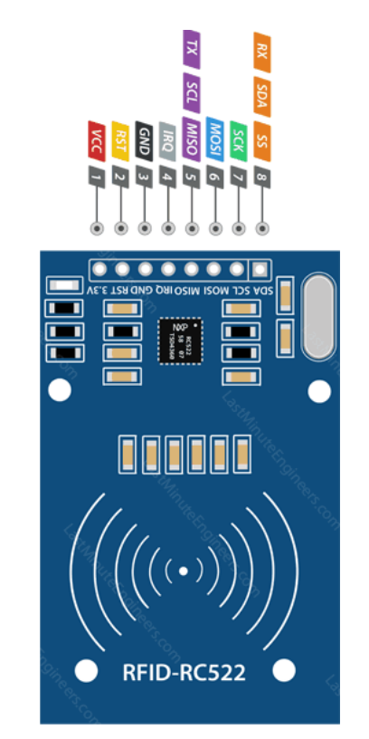
APPROACH AND METHODOLOGY PIN DIAGRAMS
ARDUINO UNO BOARD
RFID RC522

Slide 20
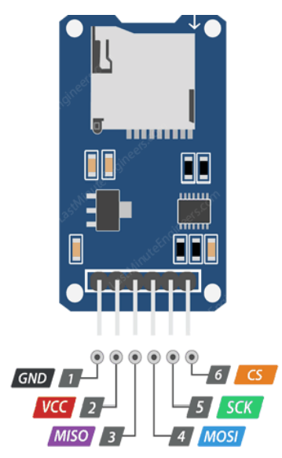
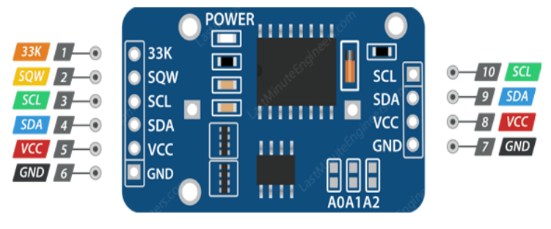
APPROACH AND METHODOLOGY PIN DIAGRAMS
SD CARD MODULE
RTC MODULE

Slide 21
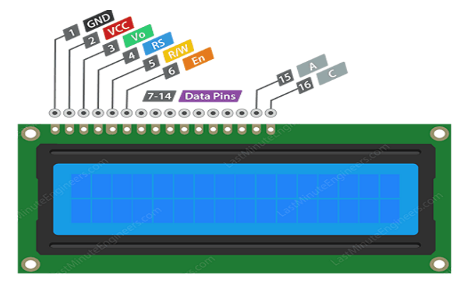
APPROACH AND METHODOLOGY PIN DIAGRAMS
LCD DISPLAY

Slide 22
APPROACH AND METHODOLOGY
Program Explanation
To program for RFID based attendance system, we first need to include header files and define input and output pin and variables.
After this we need to create a function for delay.
Then we make some function for LCD and initialize LCD function,
Here we have some function that we have used in our program. In this we have configured 9600bps baud rate at 11.0592MHz Crystal Frequency. We are monitoring the SBUF register for receiving data.
After this in main program, we have initialized LCD and UART and then we read the output of RFID when any one tag is on it. We will store this string in an array and then match with predefined array data.
If a match occurs, then controller increases the attendance by one. Else the buzzer runs continuously, and LCD shows an invalid card error message.

Slide 23
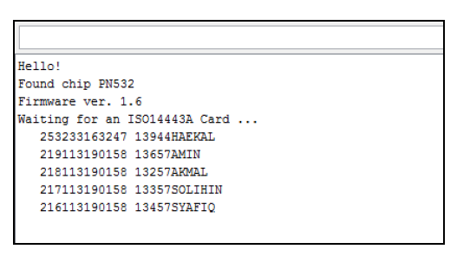
OUTPUT
In this phase, the communication between software and hardware is observed in serial monitor with 115200 baud. After the code is compiled, the serial monitor will list the database including the students’ names and their matric numbers which is stored inside the microSD card.

Slide 24
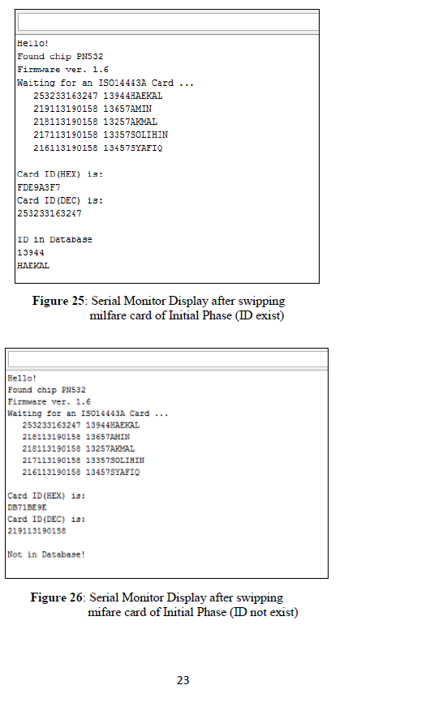
OUTPUT
After swiping an RFID card, the serial monitor will list down a few additional things which are ID card number in hexadecimal and decimal, name together with matric number of card’s owner and scanning condition. If the card is set/ stored in the database, the serial monitor will show “ID in Database” as shown in the upper figure but if the card is not set/stored, it will show “Not in Database” as shown in the lower figure.

Slide 25
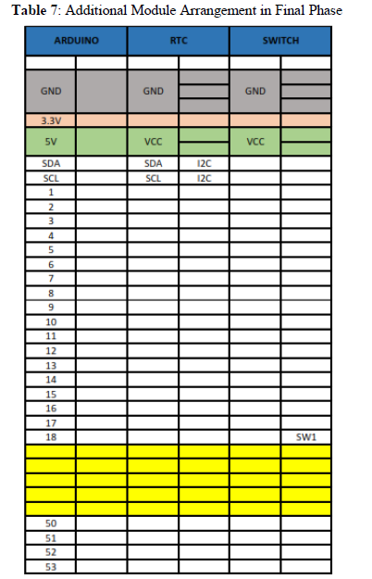
OUTPUT
Final Phase
After finishing the initial phase, the development of prototype will proceed to the most crucial part which is updated the database. From that, a few additional features must be added which are Real Time Clock (RTC) to save the attendance date/time, switches to change the state of the system and 2500 mAh power bank as a power source of this device. The table on the right shows the additional module arrangement inside the prototype.
For the software part, an additional task needs to be programmed. The updated database will be created in text.csv file and save inside the microSD card.

Slide 26
CONCLUSION
The development of a microprocessor-based automatic attendance recorder using RFID technology represents a significant advancement in modern attendance tracking systems.
This innovative solution offers numerous benefits, including accuracy, efficiency, and security. By seamlessly integrating RFID technology with a microprocessor, this system simplifies the attendance recording process, reduces the likelihood of errors, and enhances overall data management.
The real-time data collection and automated reporting capabilities contribute to increased productivity and transparency in various educational and corporate settings.

Slide 27
THANK YOU!
BY ANITEJ MISHRA, KARTIKEY MISHRA, PREM LOHIA & CHIRANJEEV KUMAR
B. TECH CSE CN (II YEAR)
Q2

